Slide 1
I/O-Algorithms
Lars Arge
Fall 2015
September 29, 2015
Notes:
<number>
Interval: 5-23 (2*45 min) (base tree balanceing start at 16)
Priority: 24-39

Slide 2
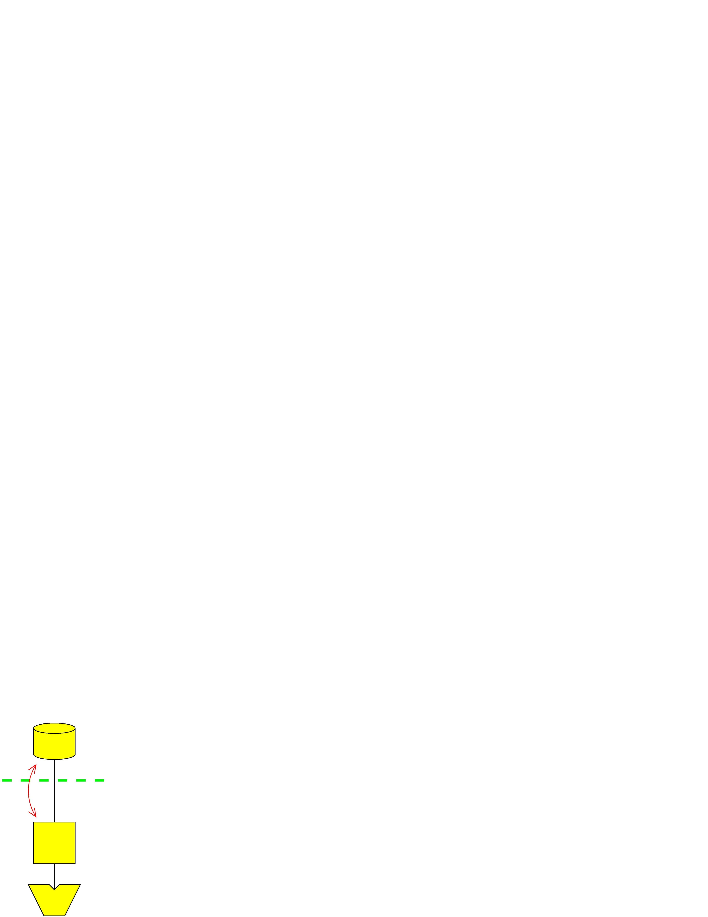
I/O-algorithms
I/O-Model
D
Parameters
N = # elements in problem instance
B = # elements that fits in disk block
M = # elements that fits in main memory
T = # output size in searching problem
We often assume that M>B²
I/O: Movement of block between memory and disk
Block I/O
M
P
Lars Arge
<number>
Notes:
<number>

Slide 3
I/O-algorithms
Fundamental Bounds
Internal External
Scanning: N
Sorting: N log N
Permuting
Searching:
Lars Arge
<number>
Notes:
<number>

Slide 4
I/O-algorithms
Fundamental Data Structures
B-trees: Node degree Θ(B) ⇒ queries in
Rebalancing using split/fuse ⇒ updates in
Weight-balanced B-tress: Weight rather than degree constraint
⇒ Ω(w(v)) updates below v between rebalancing operations on v
Persistent B-trees:
Update in current version in
Search in all previous versions in
Buffer trees
Batching of operations to obtain bounds
⇒ construction algorithms
Lars Arge
<number>
Notes:
<number>

Slide 5
I/O-algorithms
Interval Management
Problem:
Maintain N intervals with unique endpoints dynamically such that stabbing query with point x can be answered efficiently
As in (one-dimensional) B-tree case we are interested in
space
update
query
x
Lars Arge
<number>
Notes:
<number>

Slide 6
I/O-algorithms
Interval Management: Static Solution
Sweep from left to right maintaining persistent B-tree
Insert interval when left endpoint is reached
Delete interval when right endpoint is reached
Query x answered by reporting all intervals in B-tree at “time” x
space
query
construction using buffer technique
x
Lars Arge
<number>

Slide 7
I/O-algorithms
Internal Interval Tree
Base tree on endpoints – “slab” X_{v} associated with each node v
Interval stored in highest node v where it contains midpoint of X_{v}
Intervals I_{v} associated with v stored in
Left slab list sorted by left endpoint (search tree)
Right slab list sorted by right endpoint (search tree)
⇒ Linear space and O(log N) update (assuming fixed endpoint set)
Lars Arge
<number>
Notes:
<number>

Slide 8
I/O-algorithms
Internal Interval Tree
x
Query with x on left side of midpoint of X_{root}
Search left slab list left-right until finding non-stabbed interval
Recurse in left child
⇒ O(log N+T) query bound
Lars Arge
<number>
Notes:
<number>

Slide 9
I/O-algorithms
Externalizing Interval Tree
Natural idea:
Block tree
Use B-tree for slab lists
Number of stabbed intervals in large slab list may be small (or zero)
We can be forced to do I/O in each of O(log N) nodes
Lars Arge
<number>

Slide 10
I/O-algorithms
Externalizing Interval Tree
multislab
Idea:
Decrease fan-out to ⇒ height remains
slabs define multislabs
Interval stored in two slab lists (as before) and one multislab list
Intervals in small multislab lists collected in underflow structure
Query answered in v by looking at 2 slab lists and not O(log B)
Lars Arge
<number>

Slide 11
I/O-algorithms
External Interval Tree
Base tree: Weight-balanced B-tree with branching parameter
and leaf parameter B on endpoints
Interval stored in highest node v where it contains slab boundary
Each internal node v contains:
Left slab list for each of slabs
Right slab lists for each of slabs
multislab lists
Underflow structure
Interval in set I_{v} of intervals associated with v stored in
Left slab list of slab containing left endpoint
Right slab list of slab containing right endpoint
Widest multislab list it spans
If < B intervals in multislab list they are instead stored in underflow structure (⇒ contains ≤ B² intervals)
v
$m$ blocks
v
Lars Arge
<number>
Notes:
<number>

Slide 12
I/O-algorithms
External Interval tree
Each leaf contains <B/2 intervals (unique endpoint assumption)
Stored in one block
Slab lists implemented using B-trees
query
Linear space
We may “wasted” a block for each of the lists in node
But only internal nodes
Underflow structure implemented using static structure
query
Linear space
⇓
Linear space
v
Lars Arge
<number>
Notes:
<number>

Slide 13
I/O-algorithms
External Interval Tree
v
Query with x
Search down tree for x while in node v
reporting all intervals in I_{v} stabbed by x
In node v
Query two slab lists
Report all intervals in relevant multislab lists
Query underflow structure
Analysis:
Visit nodes
Query slab lists
Query multislab lists
Query underflow structure
$m$ blocks
Lars Arge
<number>
Notes:
<number>

Slide 14
I/O-algorithms
External Interval Tree
Update – ignoring base tree update/rebalancing:
Search for relevant node
Update two slab lists
Update multislab list or underflow structure
Update of underflow structure in O(1) I/Os amortized:
Maintain update block with ≤ B updates
Check of update block adds O(1) I/Os to query bound
Rebuild structure when B updates have been collected using
I/Os (Global rebuilding)
⇓
Update in I/Os amortized
v
Lars Arge
<number>
Notes:
<number>

Slide 15
I/O-algorithms
External Interval Tree
Note:
Insert may increase number of intervals in underflow structure for some multislab to B
Delete may decrease number of intervals in multislab to B
⇓
Need to move B intervals to/from multislab/underflow structure
We only move
Intervals from multislab list when decreasing to size B/2
Intervals to multislab list when increasing to size B
⇓
O(1) I/Os amortized used to move intervals
Lars Arge
<number>

Slide 16
I/O-algorithms
Base Tree Update
Before inserting new interval we insert new endpoints in base tree using I/Os
Leads to rebalancing using splits
⇓
Boundary in v becomes boundary
in parent(v)
⇓
Intervals need to be moved
Move intervals (update secondary structures) in O(w(v)) I/Os
⇒ O(1) amortized split bound (weight balanced B-tree)
⇒ amortized insert bound
v
v’
v’’
Lars Arge
<number>

Slide 17
I/O-algorithms
Splitting Interval Tree Node
When v splits we may need to move
O(w(v)) intervals
Intervals in v containing boundary
Intervals in parent(v) with endpoints
in X_{v} containing boundary
Intervals move to two new slab and multislab lists in parent(v)
Lars Arge
<number>

Slide 18
I/O-algorithms
Splitting Interval Tree Node
Moving intervals in v in O(w(v)) I/Os
Collect in left order (and remove) by scanning left slab lists
Collect in right order (and remove) by scanning right slab lists
Remove multislab lists containing boundary
Remove from underflow structure by rebuilding it
Construct lists and underflow structure for v’ and v’’ similarly
Lars Arge
<number>

Slide 19
I/O-algorithms
Splitting Interval Tree Node
Moving intervals in parent(v) in O(w(v)) I/Os
Collect in left order by scanning left slab list
Collect in right order by scanning right slab list
Merge with intervals collected in v ⇒ two new slab lists
Construct new multislab lists by splitting relevant multislab list
Insert intervals in small multislab lists in underflow structure
Lars Arge
<number>

Slide 20
I/O-algorithms
External Interval Tree
Split in O(1) I/Os amortized
Space: O(N/B)
Query:
Insert: I/Os amortized
Deletes in I/Os amortized using global rebuilding:
Delete interval as previously using I/Os
Mark relevant endpoint as deleted
Rebuild structure in after N/2 deletes
Note: Deletes can also be handled using fuse operations
v
$m$ blocks
Lars Arge
<number>

Slide 21
I/O-algorithms
External Interval Tree
External interval tree
Space: O(N/B)
Query:
Updates: I/Os amortized
Removing amortization:
Moving intervals to/from
underflow structure
Delete global rebuilding
Underflow structure update
Base node tree splits
v
Perform operations/construction lazily
Move lazily – complicated:
Interference
Queries
Lars Arge
<number>
Notes:
<number>

Slide 22
I/O-algorithms
Summary/Conclusion: Interval Management
Interval management corresponds to simple form of 2d range search
Diagonal corner queries
We obtained the same bounds as for the 1d case
Space: O(N/B)
Query:
Updates: I/Os
(x₁,x₂)
x₁
x₂
(x,x)
x
Lars Arge
<number>

Slide 23
I/O-algorithms
Summary/Conclusion: Interval Management
Main problem in designing structure:
Binary → large fan-out
Large fan-out resulted in the need for
Multislabs and multislab lists
Underflow structure to avoid O(B)-cost in each node
General solution techniques:
Filtering: Charge part of query cost to output
Bootstrapping:
Use O(B²) size structure in each internal node
Constructed using persistence
Dynamic using global rebuilding
Weight-balanced B-tree: Split/fuse in amortized O(1)
Lars Arge
<number>
Notes:
<number>

Slide 24
I/O-algorithms
Three-Sided Range Queries
Interval management: “1.5 dimensional” search
More general 2d problem: Dynamic 3-sidede range searching
Maintain set of points in plane such
that given query (q₁, q₂, q₃), all points
(x,y) with q₁ ≤ x ≤ q₂ and y ≥ q₃ can
be found efficiently
(x₁,x₂)
x₁
x₂
(x,x)
x
q₃
q₁
q₂
Lars Arge
<number>

Slide 25
I/O-algorithms
Three-Sided Range Queries
Report all points (x,y) with q₁ ≤ x ≤ q₂ and y ≥ q₃
Static solution:
Sweep top-down inserting
x in persistent B-tree at (x,y)
Answer query by performing
range query with [q₁,q₂] in
B-tree at q₃
Optimal:
O(N/B) space
O(log_{B} N+T/B) query
construction
Dynamic? … in internal memory: priority search tree
Lars Arge
<number>

Slide 26
I/O-algorithms
Internal Priority Search Tree
9
16.20
4
16
5,6
19,9
1
5
13
19
1,2
9,4
13,3
20,3
1
4
5
9
13
16
19
20
4,1
Base tree on x-coordinates with nodes augmented with points
Heap on y-coordinates
Decreasing y values on root-leaf path
(x,y) on path from root to leaf holding x
If v holds point then parent(v) holds point
Lars Arge
<number>

Slide 27
I/O-algorithms
Internal Priority Search Tree
9
Insert (10,21)
10,21
16.20
4
16
5,6
19,9
1
5
13
19
1,2
9,4
13,3
20,3
1
4
5
9
13
16
19
20
4,1
Linear space
Insert of (x,y) (assuming fixed x-coordinate set):
Compare y with y-coordinate in root
Smaller: Recursively insert (x,y) in subtree on path to x
Bigger: Insert in root and recursively insert old point in subtree
⇒ O(log N) update
Lars Arge
<number>
Notes:
<number>
Deletes similarly

Slide 28
I/O-algorithms
Internal Priority Search Tree
9
16.20
4
4
16
4
19
5,6
19,9
1
5
13
19
1,2
9,4
13,3
20,3
1
4
5
9
13
16
19
20
4,1
Query with (q₁, q₂, q₃) starting at root v:
Report point in v if satisfying query
Visit both children of v if point reported
Always visit child(s) of v on path(s) to q₁ and q₂
⇒ O(log N+T) query
Lars Arge
<number>
Notes:
<number>

Slide 29
I/O-algorithms
Externalizing Priority Search Tree
9
16.20
4
16
5,6
19,9
1
5
13
19
1,2
9,4
13,3
20,3
1
4
5
9
13
16
19
20
4,1
Natural idea: Block tree
Problem:
I/Os to follow paths to to q₁ and q₂
But O(T) I/Os may be used to visit other nodes (“overshooting”)
⇒ query
Lars Arge
<number>
Notes:
<number>

Slide 30
I/O-algorithms
Externalizing Priority Search Tree
9
16.20
4
16
5,6
19,9
1
5
13
19
1,2
9,4
13,3
20,3
1
4
5
9
13
16
19
20
4,1
Solution idea:
Store B points in each node ⇒
O(B²) points stored in each supernode
B output points can pay for “overshooting”
Bootstrapping:
Store O(B²) points in each supernode in static structure
Lars Arge
<number>

Slide 31
I/O-algorithms
External Priority Search Tree
Base tree: Weight-balanced B-tree with branching parameter B/4 and leaf parameter B on x-coordinates
Points in “heap order”:
Root stores B top points for each of the child slabs
Remaining points stored recursively
Points in each node stored in “B²-structure”
Persistent B-tree structure for static problem
⇓
Linear space
Lars Arge
<number>

Slide 32
I/O-algorithms
External Priority Search Tree
Query with (q₁, q₂, q₃) starting at root v:
Query B²-structure and report points satisfying query
Visit child v if
v on path to q₁ or q₂
All points corresponding to v satisfy query
Lars Arge
<number>
Notes:
<number>

Slide 33
I/O-algorithms
External Priority Search Tree
Analysis:
I/Os used to visit node v
nodes on path to q₁ or q₂
For each node v not on path to q₁ or q₂ visited, B points reported in parent(v)
⇓
query
Lars Arge
<number>

Slide 34
I/O-algorithms
External Priority Search Tree
Insert (x,y) (ignoring insert in base tree - rebalancing):
Find relevant node u:
Query B²-structure to find B
points in root corresponding
to node u on path to x
If y smaller than y-coordinates
of all B points then recursively
search in u
Insert (x,y) in B²-structure of v
If B²-structure contains >B points for child u, remove lowest point and insert recursively in u
Delete: Similarly
u
Lars Arge
<number>

Slide 35
I/O-algorithms
External Priority Search Tree
Analysis:
Update visits nodes
B²-structure queried/updated in each node
One query
One insert and one delete
B²-structure analysis:
Query:
Update: O(1) using global rebuilding
Store updates in update block
Rebuild after B updates using I/Os
⇓
I/O updates
u
Lars Arge
<number>
Notes:
<number>

Slide 36
I/O-algorithms
Dynamic Base Tree
Deletion:
Delete point as previously
Delete x-coordinate from base
tree using global rebuilding
⇒ I/Os amortized
Insertion:
Insert x-coordinate in base tree
and rebalance (using splits)
Insert point as previously
Split: Boundary in v becomes boundary in parent(v)
v
v’
v’’
Lars Arge
<number>
Notes:
<number>
Explain global rebuilding

Slide 37
I/O-algorithms
Dynamic Base Tree
Split: When v splits B new points needed in parent(v)
One point obtained from v’ (v’’) using “bubble-up” operation:
Find top point p in v’
Insert p in B²-structure
Remove p from B²-structure of v’
Recursively bubble-up point to v’
Bubble-up in I/Os
Follow one path from v to leaf
Uses O(1) I/O in each node
⇓
Split in I/Os
v’
v’’
Lars Arge
<number>
Notes:
<number>

Slide 38
I/O-algorithms
Dynamic Base Tree
O(1) amortized split cost:
Cost: O(w(v))
Weight balanced base tree: inserts below v between splits
⇓
External Priority Search Tree
Space: O(N/B)
Query:
Updates: I/Os amortized
Amortization can be removed from update bound in several ways
Utilizing lazy rebuilding
v’
v’’
Lars Arge
<number>

Slide 39
I/O-algorithms
Summary/Conclusion: Priority Search Tree
We have now discussed structures for special cases of two-dimensional range searching
Space: O(N/B)
Query:
Updates:
Cannot be obtained for general (4-sided) 2d range searching:
query requires space
space requires query
q
q₃
q
q₁
q₂
q₄
q₃
q₁
q₂
Lars Arge
<number>

Slide 40
I/O-algorithms
References
External Memory Geometric Data Structures
Lecture notes by Lars Arge.
Section 6-7
Lars Arge
<number>

